Slide 1

ER Modeling II

Slide 2
ER Structure
English grammar structure ER structure
Common noun Entity type
Proper noun Entity
Transitive verb Relationship type
Intransitive verb Attribute type
Adjective Attribute for entity
Adverb Attribute for relationship

Slide 3
Associative Entity
An associative entity is an element of the entity–relationship model. The database relational model does not offer direct support to many-to-many relationships, even though such relationships happen frequently in normal usage. The solution to this problem is the creation of another table to hold the necessary information for this relationship. This new table is called an associative entity.
An associative entity can be thought of as both an entity and a relationship since it encapsulates properties from both. It is a relationship since it is serving to join two or more entities together, but it is also an entity since it may have its own properties. The associative entity must have the primary keys of both adjoining tables as identifiers, but may also contain its own unique identifier and other information about the relationship

Slide 4
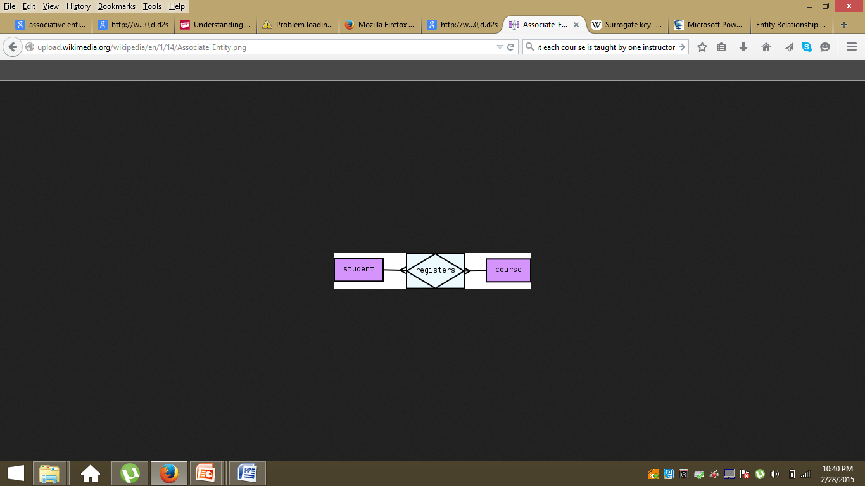
Associative Entity

Slide 5
Example I
A college contains many departments
Each department can offer any number of courses
Many instructors can work in a department
An instructor can work only in one department
For each department there is a Head
An instructor can be head of only one department
Each instructor can take any number of courses
A course can be taken by only one instructor
A student can enroll for any number of courses
Each course can have any number of students

Slide 6
Example I
Identify the Entities
What are the entities here?
From the statements given, the entities are
Department
Course
Instructor
Student

Slide 7
Example I
Identify the relationships
One department offers many courses. But one particular course can be offered by only one department. hence the cardinality between department and course is One to Many (1:N)
One department has multiple instructors . But instructor belongs to only one department. Hence the cardinality between department and instructor is One to Many (1:N)
One department has only one head and one head can be the head of only one department. Hence the cardinality is one to one. (1:1)
One course can be enrolled by many students and one student can enroll for many courses. Hence the cardinality between course and student is Many to Many (M:N)
One course is taught by only one instructor. But one instructor teaches many courses. Hence the cardinality between course and instructor is Many to One (N :1)

Slide 8
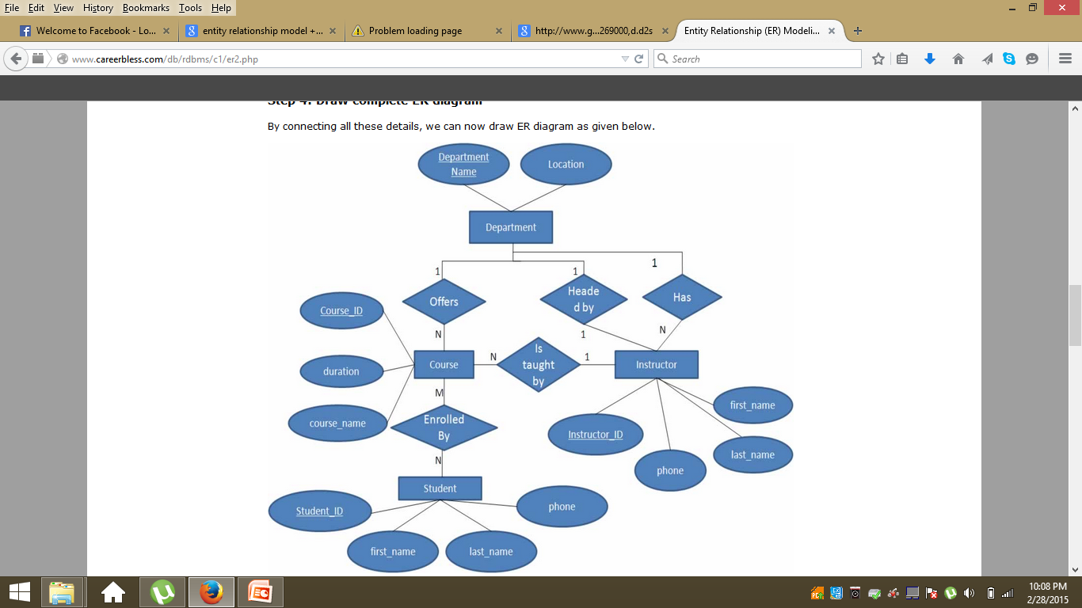
ER-Model-I

Slide 9
Example II
A company database needs to store information about employees (identified by ssn, with salary and phone )departments (identified by dno, with dname and budget), and children of employees (with name and age).
Employees work in departments; each department is managed by an employee; a child must be identified uniquely by name when the parent (who is an employee; assume that only one parent works for the company) is known. We are not interested in information about a child once the parent leaves the company.

Slide 10
Example II
A company database needs to store information about employees (identified by ssn, with salary and phone), departments (identified by dno, with dname and budget), and children of employees (with name and age).
Employees work in departments; each department is managed by an employee; a child must be identified uniquely by name when the parent (who is an employee; assume that only one parent works for the company) is known. We are not interested in information about a child once the parent leaves the company.

Slide 11
Example II
A company database needs to store information about employees (identified by ssn, with salary and phone), departments (identified by dno, with dname and budget as attributes), and children of employees (with name and age).
Employees work in departments; each department is managed by an employee; a child must be identified uniquely by name when the parent (who is an employee; assume that only one parent works for the company) is known. We are not interested in information about a child once the parent leaves the company.

Slide 12
Example II
A company database needs to store information about employees (identified by ssn, with salary and phone), departments (identified by dno, with dname and budget as attributes), and children of employees (with name and age).
Employees work in departments; each department is managed by an employee; a child must be identified uniquely by name when the parent (who is an employee; assume that only one parent works for the company) is known. We are not interested in information about a child once the parent leaves the company.

Slide 13
ER-Model-II
phone
dname
ssn
salary
budget
dno
Manages
Employees
Department
Dependent
Works in
Child
name
age

Slide 14
Example III
Galleries keep information about artists, their names (which are unique), birthplaces, age, and style of art. For each piece of artwork, the artist, the year it was made, its unique title, its type of art (e.g., painting, sculpture, photograph), and its price must be stored. Pieces of artwork are also classified into groups of various kinds, for example, portraits works by Picasso, or works of the 19th century; a given piece may belong to more than one group.
Each group is identified by a name (like those just given) that describes the group. Finally, galleries keep information about customers. For each customer, galleries keep that person’s unique name, address, total amount of dollars spent in the gallery (very important!), and the artists and groups of art that the customer tends to like.
Draw the ER diagram for the database.

Slide 15
Example III- Entites
Galleries keep information about artists, their names (which are unique), birthplaces, age, and style of art. For each piece of artwork, the artist, the year it was made, its unique title, its type of art (e.g., painting, sculpture, photograph), and its price must be stored. Pieces of artwork are also classified into groups of various kinds, for example, portraits works by Picasso, or works of the 19th century; a given piece may belong to more than one group.
Each group is identified by a name (like those just given) that describes the group. Finally, galleries keep information about customers. For each customer, galleries keep that person’s unique name, address, total amount of dollars spent in the gallery (very important!), and the artists and groups of art that the customer tends to like.
Draw the ER diagram for the database.

Slide 16
Example III- Attributes
Galleries keep information about artists, their names (which are unique), birthplaces, age, and style of art. For each piece of artwork, the artist, the year it was made, its unique title, its type of art (e.g., painting, sculpture, photograph), and its price must be stored. Pieces of artwork are also classified into groups of various kinds, for example, portraits works by Picasso, or works of the 19th century; a given piece may belong to more than one group.
Each group is identified by a name (like those just given) that describes the group. Finally, galleries keep information about customers. For each customer, galleries keep that person’s unique id, name, address, total amount of dollars spent in the gallery (very important!), and the artists and groups of art that the customer tends to like.
Draw the ER diagram for the database.

Slide 17
Example III- Attributes
Galleries keep information about artists, their names (which are unique), birthplaces, age, and style of art. For each piece of artwork, the artist, the year it was made, its unique title, its type of art (e.g., painting, sculpture, photograph), and its price must be stored. Pieces of artwork are also classified into groups of various kinds, for example, portraits works by Picasso, or works of the 19th century; a given piece may belong to more than one group.
Each group is identified by a name (like those just given) that describes the group. Finally, galleries keep information about customers. For each customer, galleries keep that person’s unique id,name, address, total amount of dollars spent in the gallery (very important!), and the artists and groups of art that the customer tends to like.
Draw the ER diagram for the database.

Slide 18
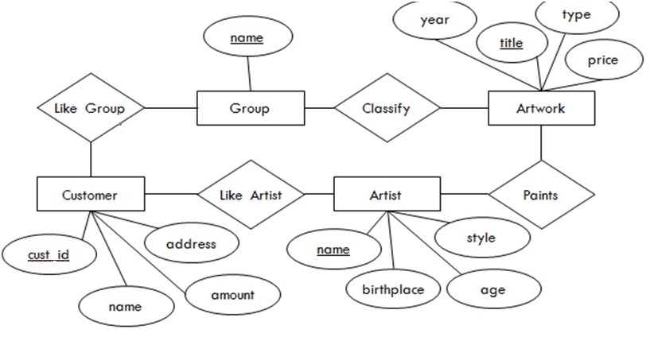
ER-Model-III

Slide 19
Case Study I-DIY
In our database, we have students. They have a name, a registration number, and a course of study. The university offers lectures. Each lecture may be part of some course of study in a certain semester. Lectures may have other lectures as prerequisites. They have a title, provide a specific number of credits and have a unique ID Each year, some of these lectures are offered by a professor at a certain day at a fixed time in a specific room. Students may register for that lecture. Professors have a name and are member of a specific department

Slide 20
Case Study II-DIY
The craft trading website ABC is setting up a database to record sellers and their products.
This requires recording the following information:
For each seller, their name, contact email, and postal address.
For each product, its name, price, and number available.
Which product is from which seller.
A unique id number for each product.
Draw an entity-relationship (ER) diagram that represents this information.
Make sure to capture the constraints on the relationships involved, and designate appropriate primary keys for the entities.

